Slide 1
Resume Classifications Of Data Science
Teammates:
Mr. Abdul Aamir Khan
Mr. Swapnil Chavan
Mr. Vajrala Venkata Sai Prakash Reddy
Mr. Renjith Raju
Ms. Chikkondu Lakshmi Prasanna
Ms. Varsha

Slide 2

Problem
Notes:
To classify the resumes revceived from candidates to correct category

Slide 3
Problem
A
B
C
D

Slide 4
Project Flow
Data Collection
EDA
Data cleaning
Model Building
Classification Model
Textract
Deployment
RShiny or Flask or stream lit

Slide 5
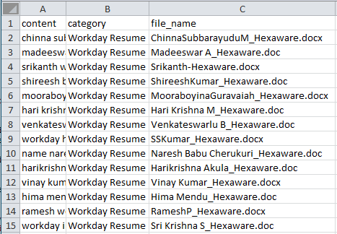
Data Collection
Textract

Slide 6
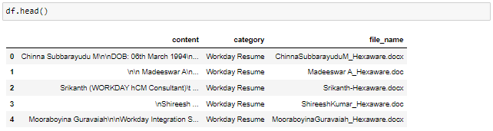
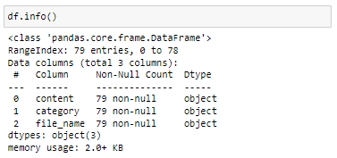
Exploratory Data Analysis

Slide 7
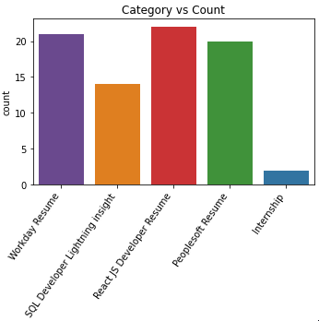
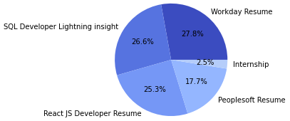
Exploratory Data Analysis
Category Distribution/count

Slide 8

Exploratory Data Analysis
Data Cleaning
lower the text
Remove all the unwanted characters

Slide 9
Exploratory Data Analysis
Data Cleaning
Word Tokenization
Remove stop words

Slide 10


Exploratory Data Analysis
Data Cleaning
Stemming
Lemmatization

Slide 11
Exploratory Data Analysis
A
Wordcloud
B
C
A : Peoplesoft Resume
B : React JS Developer
C : SQL Developer
D : Workday Resumes
D

Slide 12
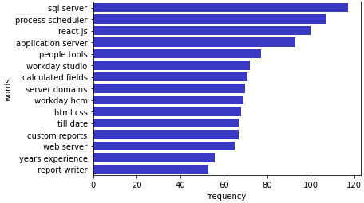
Exploratory Data Analysis
Mostly repeated bigrams

Slide 13
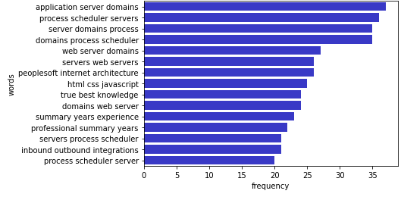
Exploratory Data Analysis
Mostly repeated trigrams

Slide 14
Model Building.....
Split Data
Using Tfidf Vectoriser convert collection or row data into metrics forms.
Split the into training and testing datasets.

Slide 15
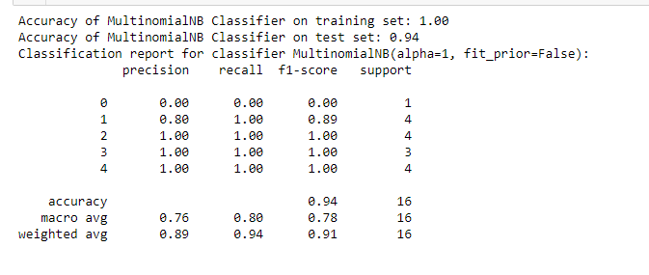
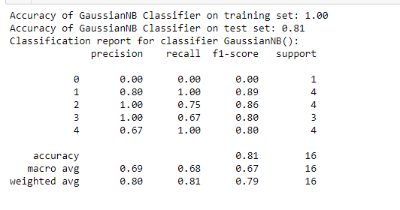
1. Naive Bayes
A) Multinomial NB
B) Gaussian NB

Slide 16
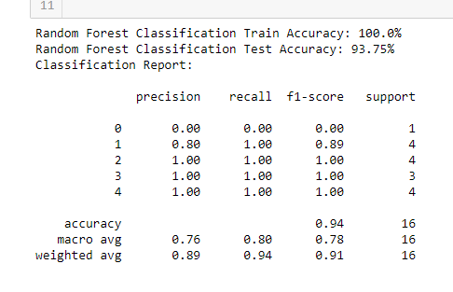
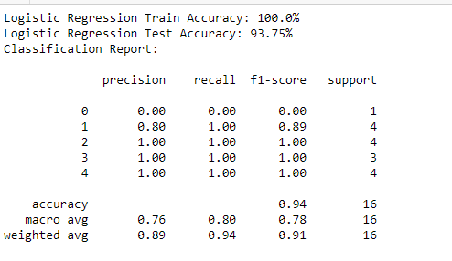
2. Random Forest Classifier.
3. Logistic Classifier.

Slide 17
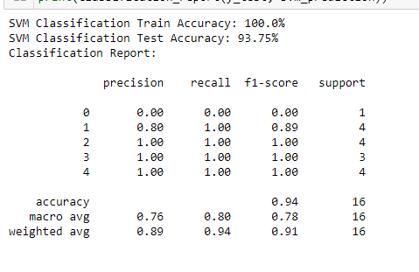
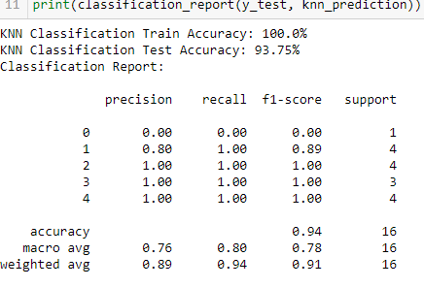
4.SVM
5. KNN

Slide 18
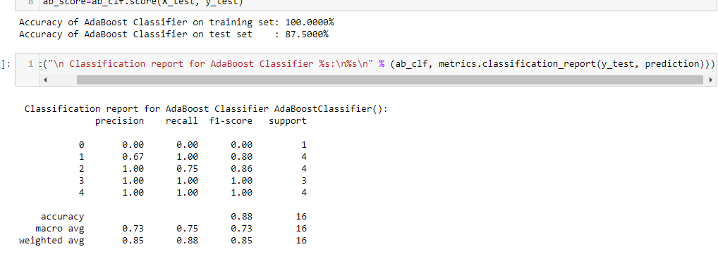
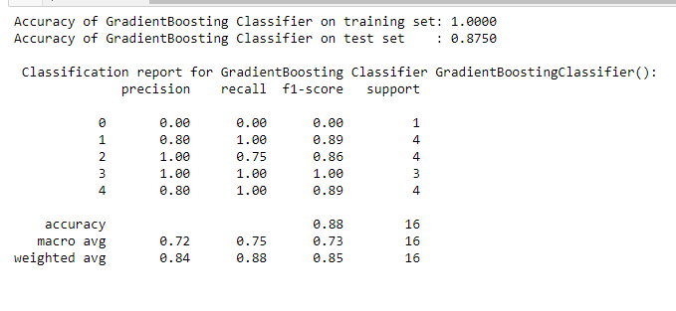
6. AdaBoost classifier.
7.GradiantBoost Classifier

Slide 19
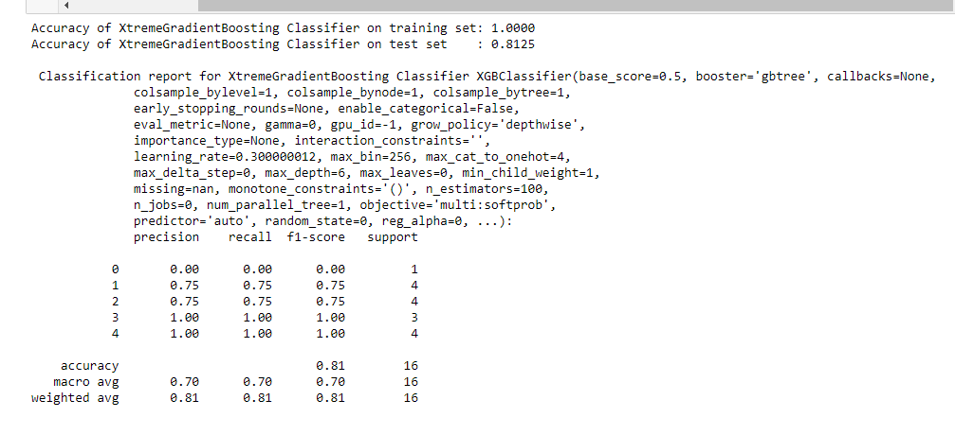
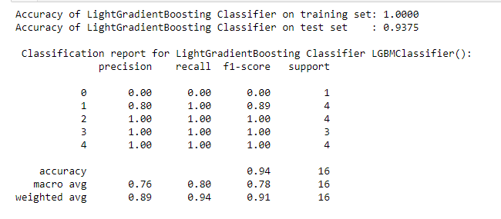
8. XGB Classifier.
9.LGBM Classifier

Slide 20
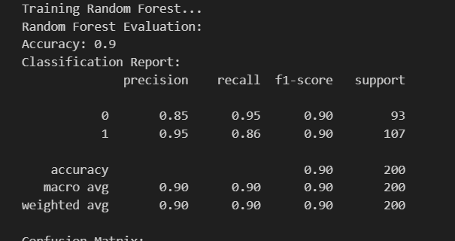
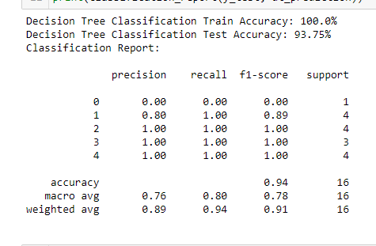
After evaluating all the models we found as random forest having the maximum accuracy result.

Slide 21
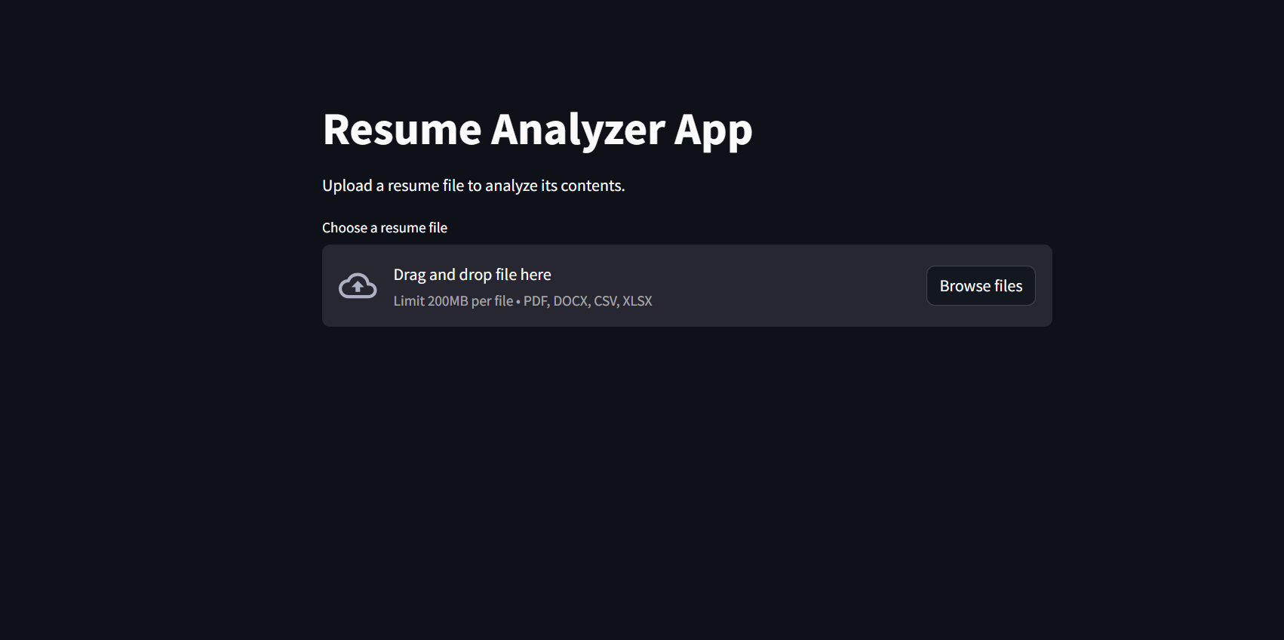
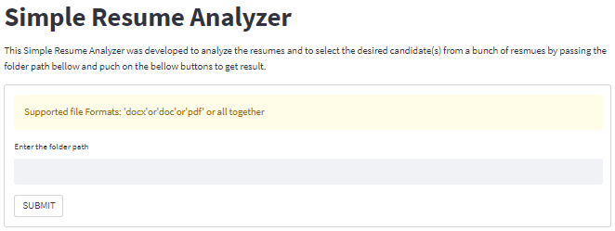
Deplyment
Web Interface of streamlit Deployment

Slide 22
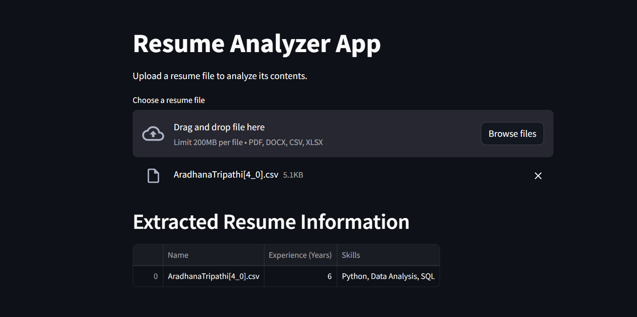
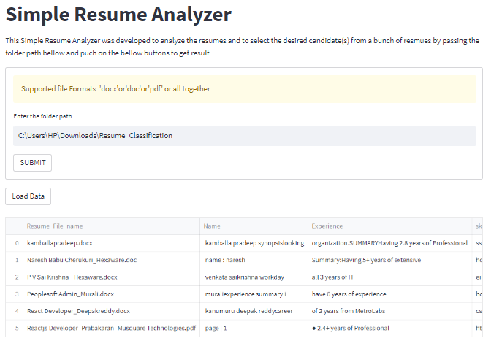
Deplyment
Result

Slide 23
Thank You

